Slide 1

NOTES
An interactive website using python and flask

Slide 2
Project by : 1) Prajwal V. Ankushrao 19UET001 2) Shreekumar R. Futane 19UET010 3)Brijesh S. Gaikwad 19UET011 4) Anant R. Hasabe 19UET013

Slide 3
Introduction The sources of information are flooding our brain with lots of information. But we are humans so we save context of it. This is the main aim of NOTES. We have created a simple yet effective website where we can save our notes. We have used Python a powerful yet simple programming language and web-framework Flask to create our website. We have introduced user authentication system using database management.

Slide 4

How it works? 1) User authentication. If new user signup else login. 2) Create note. 3) Save note. 4) Logout user.

Slide 5




What we have used? 1) Python 2) Flask 4) SQL 3) HTML 4) CSS bootstrap templates.

Slide 6
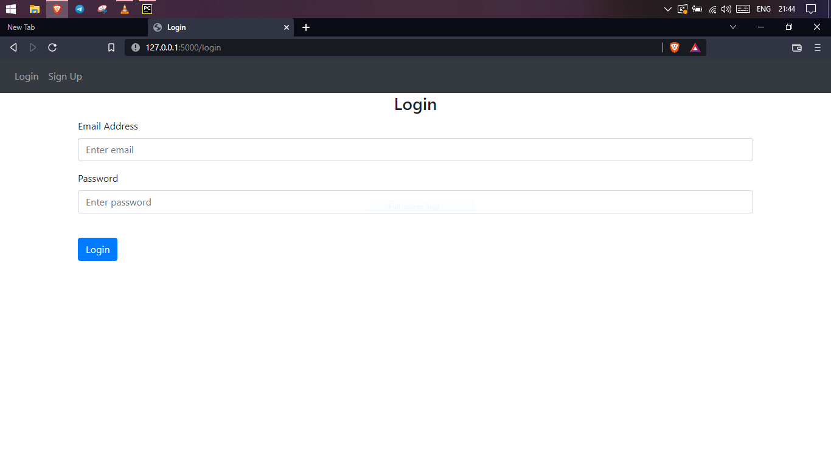

How things looks?

Slide 7
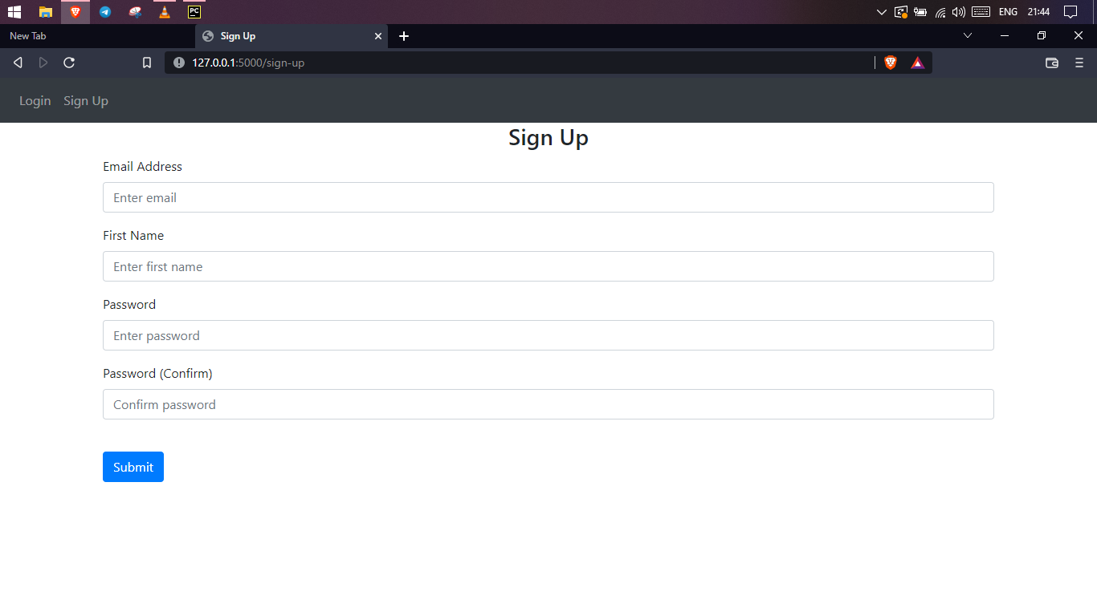

Slide 8
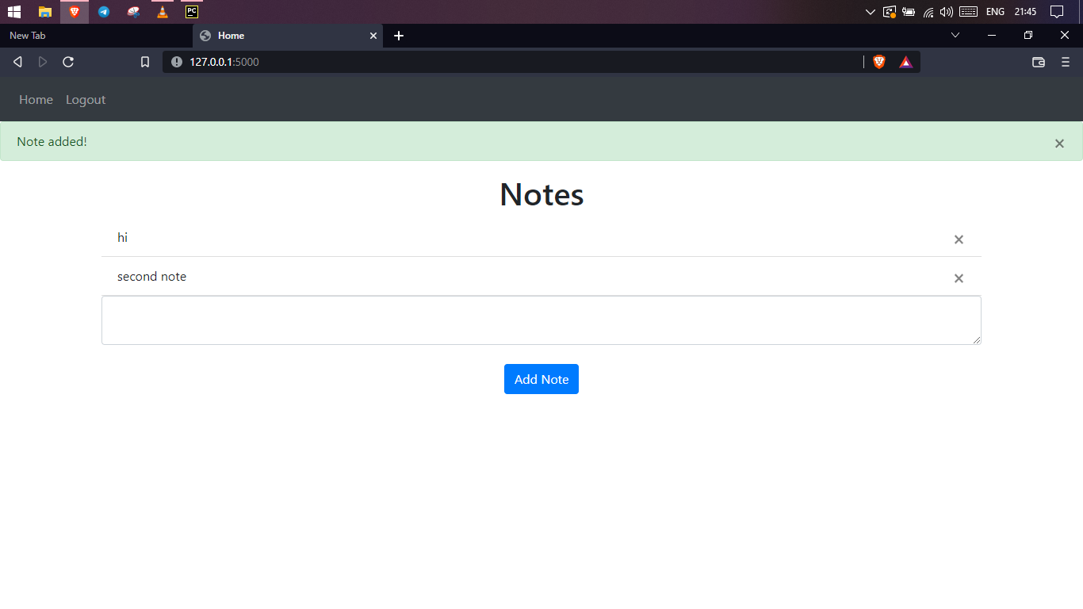

Slide 9
Thank You !

